Slide 1
LEAP 4.0 PRESENTATION WEEK 1 TRIBE - C

Slide 2
What is an API?

Slide 3
How does an API work?

Slide 4
Types of APIs
1
Web APIs
Logical APIs
Program APIs

Slide 5
Real Life Examples
2
Weather Reports
Login within Standardized platform
Payment Features
Travel Booking

Slide 6
Project Scope
Project Needs
Objectives and Goals
Deliverables
Inclusions and Exclusions / out of scope
Constraints
Necessary Changes

Slide 7
Functional Requirements and its examples
3
Any requirement which specifies what the system should do.
Examples:
1. Mobile Applications
2. Web page
3. Financial Transactions
4. Self-serve portal
5. Business Connections

Slide 8
Non-Functional Requirements
4
Performance
Reliability
Scalability
Security
Usability

Slide 9
Example of API Implementation Requirements
API Requirement | SOAP | REST
User Authentication | WS-Security Supporting Token | OAuth
Data Privacy | WS-Security Message Encryption | HTTPS
App authentication | WS-Security Message Signature | HMAC Header Signature or OAuth

Slide 10
Purpose of Business Driver
5
What
How
Technology
For whom

Slide 11
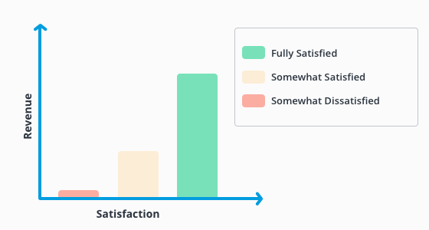
Customer Satisfaction

Slide 12
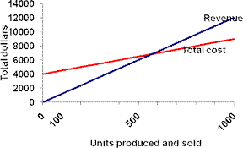
Cost & Revenue

Slide 13
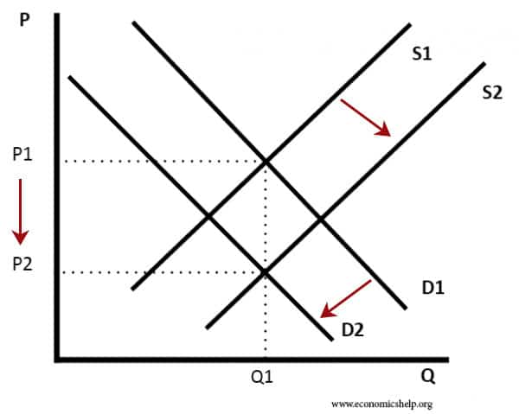
Demand & Supply

Slide 14
AWS Cloud Business Driver
6
Cost Saving
Staff Productivity
Operational Resiliance
Business Agility

Slide 15
Benefits & Costs
7
Automation
Application
Adaptation
Improves Marketing
Enhances Customer Experience
Improves Connectivity and collaboration
Saves costs

Slide 16
Schedule & Timeline
WEEK | DATES | TASKS
1 | 20 June –26 June | Presenting Business Requirement Document (BRD)
2 | 27 June – 03 July | Preparing Solution Document Setting up hardware and software environment
3 | 4 July – 10 July | Development phase 1 Complete 50% of our project development
4 | 11 July – 17 July | Development Phase 2 Prepared to present the developed product
5 | 18 July – 24 July | Demonstration of the working prototype Testing different user cases
6 | 24 July -31 July | Improving the development based on test results Final demonstration of working prototype Testing results Present Consumer Acceptance Document

